Slide 1

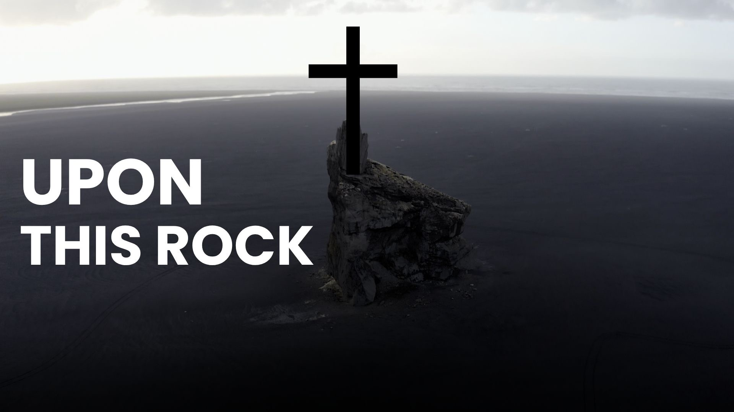
Upon This Rock (Core Values)

Slide 2
Cedar Grove Baptist Church exists to create a space where people and families can meet Jesus, find community, and grow in their faith.

Slide 3
Our purpose is to love others unconditionally, learn about God increasingly, live to share Jesus intentionally and lead others to Christ continually in Lebanon, TN and throughout the whole world.

Slide 4
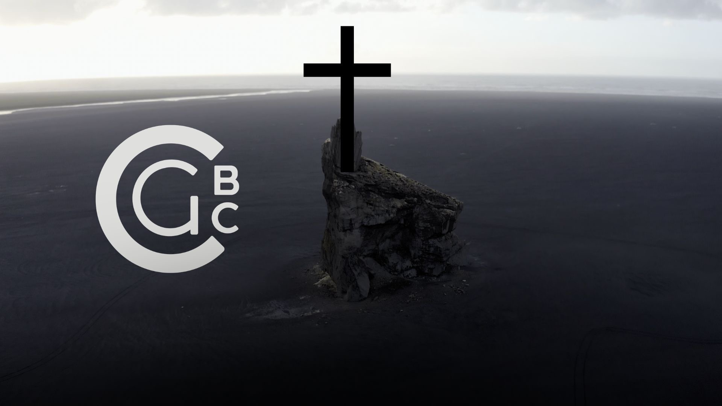

Slide 5
23 Let us hold fast the confession of our hope without wavering, for He who promised is faithful. 24 And let us consider one another in order to stir up love and good works,
Hebrews 10:23–25
NKJV

Slide 6
25 not forsaking the assembling of ourselves together, as is the manner of some, but exhorting one another, and so much the more as you see the Day approaching.
Hebrews 10:23–25
NKJV

Slide 7
2 fulfill my joy by being like-minded, having the same love, being of one accord, of one mind.
Philippians 2:2
NKJV

Slide 8
Accountability

Slide 9
I will exhibit accountability in my relationship with Christ and with fellow believers

Slide 10
Accountability, in a biblical context, refers to the responsibility of individuals to answer for their actions, decisions, and stewardship before God and, at times, before others. It encompasses the idea that humans are answerable to God for their moral and ethical conduct, as well as their use of the resources and talents entrusted to them.

Slide 12
By growing daily in the grace and knowledge of the Lord Jesus Christ and submitting to His Lordship

Slide 13
Justification. Sanctification. Glorification.

Slide 14
Justification is God declaring a person righteous.

Slide 15
10 as it is written, “There is none righteous, not even one;
Romans 3:10
NASB95

Slide 16
1 Therefore, having been justified by faith, we have peace with God through our Lord Jesus Christ,…
Romans 5:1
NASB95

Slide 17
something or someone being set apart for holiness

Slide 19
3 For this is the will of God, your sanctification; that is, that you abstain from sexual immorality; 4 that each of you know how to possess his own vessel in sanctification and honor, 5 not in lustful passion, like the Gentiles who do not know God;
1 Thessalonians 4:3–7
NASB95

Slide 20
6 and that no man transgress and defraud his brother in the matter because the Lord is the avenger in all these things, just as we also told you before and solemnly warned you. 7 For God has not called us for the purpose of impurity, but in sanctification.
1 Thessalonians 4:3–7
NASB95

Slide 21
ἁγιασμός (hagiasmos). n. masc. sanctification, holiness, consecration. Refers either to the process of becoming holy, by which the state of holiness is attained, or to the end result that the sanctifying work has obtained.
Lexham Theological Wordbook

Slide 22
Glorification is God’s final removal of sin from the life of the saints in the eternal state

Slide 23
17 For our light affliction, which is but for a moment, is working for us a far more exceeding and eternal weight of glory,
2 Corinthians 4:17–18
NKJV

Slide 24
18 while we do not look at the things which are seen, but at the things which are not seen. For the things which are seen are temporary, but the things which are not seen are eternal
2 Corinthians 4:17–18
NKJV

Slide 25
By growing daily in the grace and knowledge of the Lord Jesus Christ and submitting to His Lordship

Slide 26
12 Not that I have already obtained it or have already become perfect, but I press on so that I may lay hold of that for which also I was laid hold of by Christ Jesus.
Philippians 3:12
NASB95

Slide 28
13 Brethren, I do not regard myself as having laid hold of it yet; but one thing I do: forgetting what lies behind and reaching forward to what lies ahead, 14 I press on toward the goal for the prize of the upward call of God in Christ Jesus.
Philippians 3:13–14
NASB95

Slide 29
15 Let us therefore, as many as are perfect, have this attitude; and if in anything you have a different attitude, God will reveal that also to you;
Philippians 3:15–17
NASB95

Slide 30
16 however, let us keep living by that same standard to which we have attained. 17 Brethren, join in following my example, and observe those who walk according to the pattern you have in us.
Philippians 3:15–17
NASB95

Slide 31
7 But whatever things were gain to me, those things I have counted as loss for the sake of Christ.
Philippians 3:7–11
NASB95

Slide 32
8 More than that, I count all things to be loss in view of the surpassing value of knowing Christ Jesus my Lord, for whom I have suffered the loss of all things, and count them but rubbish so that I may gain Christ,
Philippians 3:7–11
NASB95

Slide 33
9 and may be found in Him, not having a righteousness of my own derived from the Law, but that which is through faith in Christ, the righteousness which comes from God on the basis of faith,
Philippians 3:7–11
NASB95

Slide 34
10 that I may know Him and the power of His resurrection and the fellowship of His sufferings, being conformed to His death; 11 in order that I may attain to the resurrection from the dead.
Philippians 3:7–11
NASB95

Slide 36
18 He is also head of the body, the church; and He is the beginning, the firstborn from the dead, so that He Himself will come to have first place in everything
Colossians 1:18
NASB95

Slide 37
By growing daily in the grace and knowledge of the Lord Jesus Christ and submitting to His Lordship

Slide 38
By beginning and growing accountability partnerships with fellow believers

Slide 39
17 Iron sharpens iron, So one man sharpens another.
Proverbs 27:17
NASB95

Slide 40
1 Brethren, even if anyone is caught in any trespass, you who are spiritual, restore such a one in a spirit of gentleness; each one looking to yourself, so that you too will not be tempted.
Galatians 6:1
NASB95

Slide 41
17 Iron sharpens iron, So one man sharpens another.
Proverbs 27:17
NASB95

